Slide 1
East Anglia Chairmans’ Conference
Welcome
http://eastanglia.bmfa.org/

Slide 2
Introduction
How we got here –
A decision by the current Area committee to commit to working towards the following –
Better communication to area clubs and members
Support for clubs to maintain members
Continuous improvement of safety
Aim’s of this conference –
To be able to engage with area Clubs
Give meaningful support to club officials
To see if this format should be done again and on what topics?

Slide 3
Conference agenda
An insight into the new BMFA membership portal “Go Membership” by Andy Symons BMFA Club support officer.
BMFA website hosting for your Club by Andy and Mike
Data Protection – GDPR and how it effects you by Andy
Break for buffet 7.30pm – 8.10pm (Phil Gutteridge Achievement scheme co-Ordinator).
How to improve and maintain your membership by Paul Hoey EA BMFA area council delegate.
How Clubs can use social media to promote membership by Paul Tallett BMFA marketing consultant.
Closing remarks by all and any questions hosted by Peter Jenkins and Mike Woodhouse EA BMFA Secretary & Treasurer.

Slide 4
East Anglia Chairmans’ Conference
http://eastanglia.bmfa.org/
Notes:
Bear with us re the technical change overs,

Slide 5
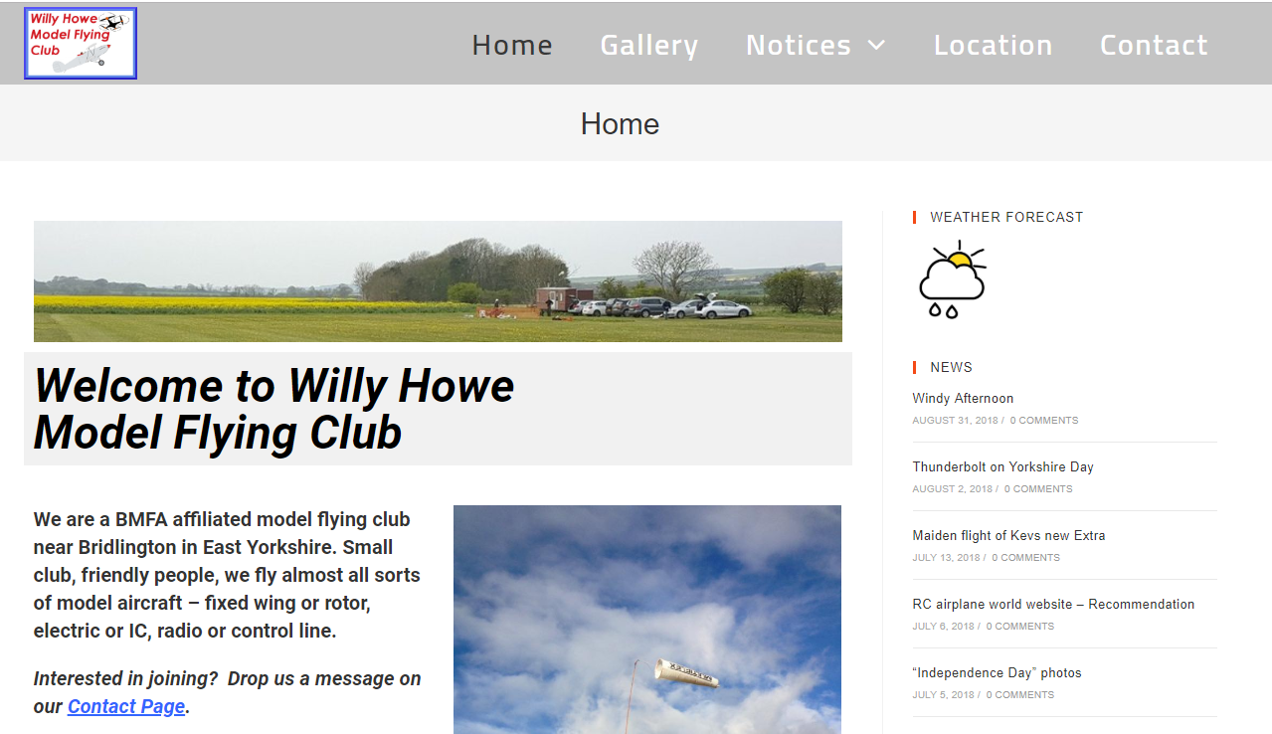
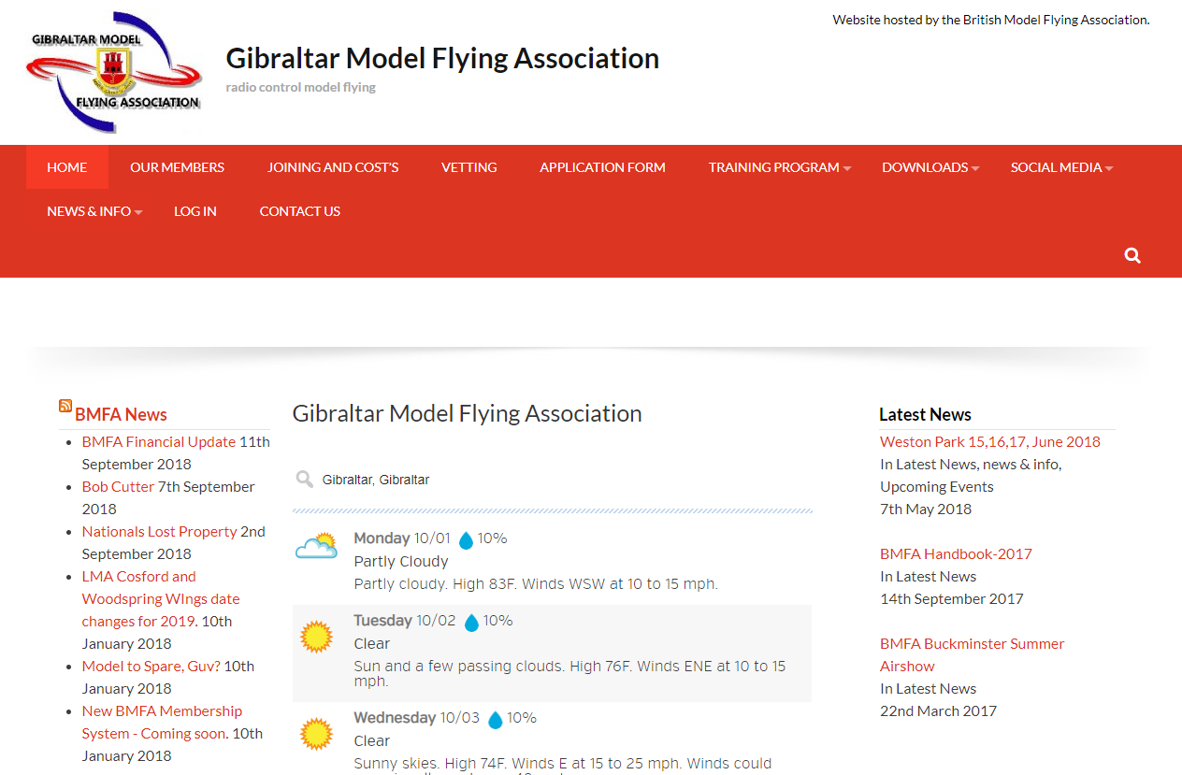
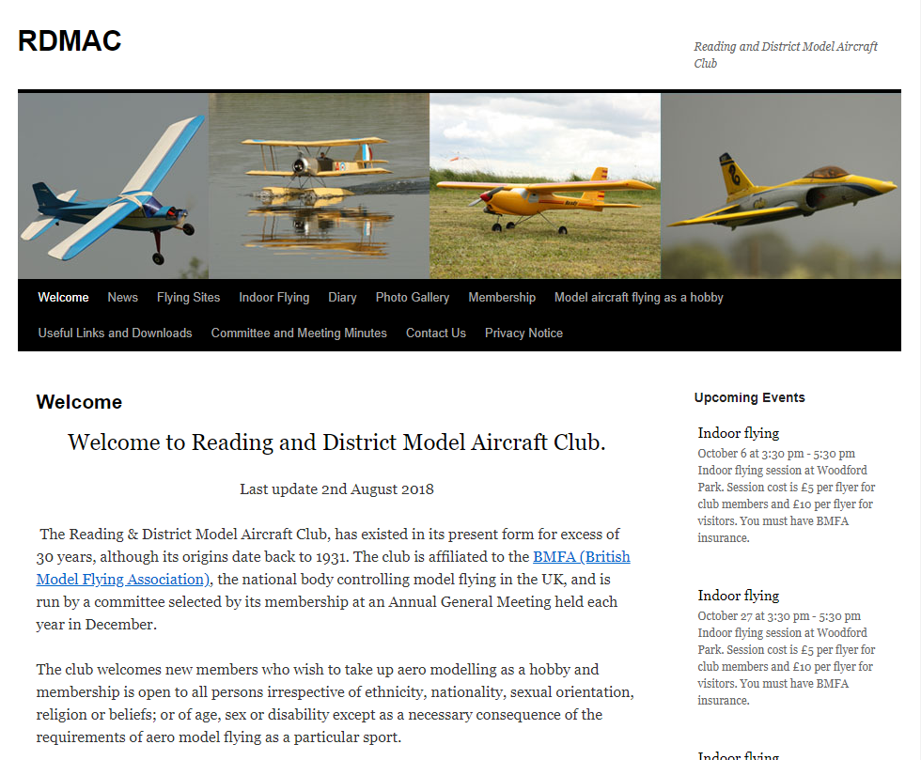
BMFA Hosted Web site’s

Slide 6
Free of charge service to affiliated clubs
Club websites are an excellent way to publicise your activities and while many clubs already have excellent websites many have no online presence at all.
Registered domain name e.g. http://yourmac.bmfa.org
hosting service
Wordpress platform
Clearly display on PC’s and mobile devices
Integrate neatly with the various social media platforms.

Slide 7
Mid Suffolk’s web site
http://msrm.bmfa.org/

Slide 8
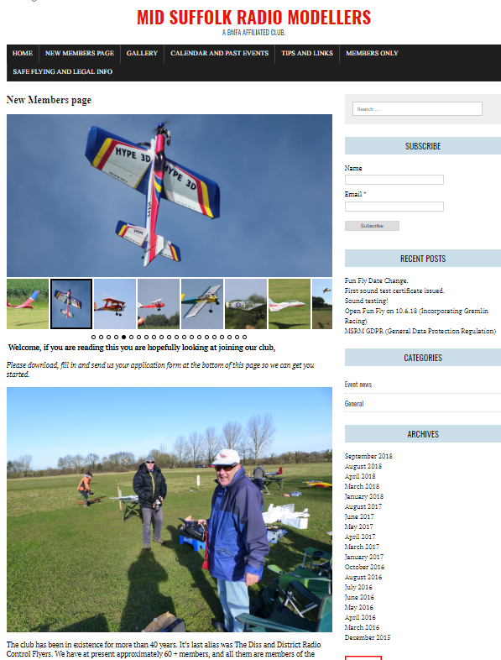
New members page

Slide 9
Events

Slide 10
Club documents – Minutes - Enrolment form - Constitution - Etc..

Slide 11
Info pages - Mowing rota - Flying times - Contact details for instructors etc..

Slide 12
Our learnings –
Have one person set it up
You need content!
You need lots of pictures.
Have more than one person updating.
Its easy to use/ setup if you are prepared to take the time to learn the basics.
Keep it fresh.
Don’t put anything on the site you wouldn’t give to the Sun news paper!
It will bring in new members.

Slide 13
To take advantage of this service –
Decide on what domain name you wish to use
Email webmaster@bmfa.org
Who will administer the website
Andy will then setup the website with a few basic pages to get you started and send details of how to login to your named website administrators.

