Slide 1
New BMFA Membership Portal
For Clubs
For Individuals

Slide 2
For Individuals

Slide 3
For Clubs

Slide 4
New BMFA membership system will help clubs meet their GDPR responsibilities!

Slide 5
That’s great but….
Wouldn’t it be great if you could also collect club subs online too!

Slide 6
Ok, go on then……
Introducing
Club +

Slide 7
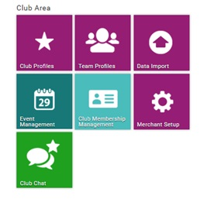
Functions for
Club Membership Management – define and amend membership types;
Event Management – set up and amendment of new events;
Merchant Setup – defining “products” e.g. membership type, event type etc.
Club Chat
– Club Email communications

Slide 8
Members can join and renew both club subs and BMFA membership online.
Accept Credit/Debit card payments.
Payments by instalments.
Automatic renewals (optional)
Members can still do things the old fashioned way!

Slide 9
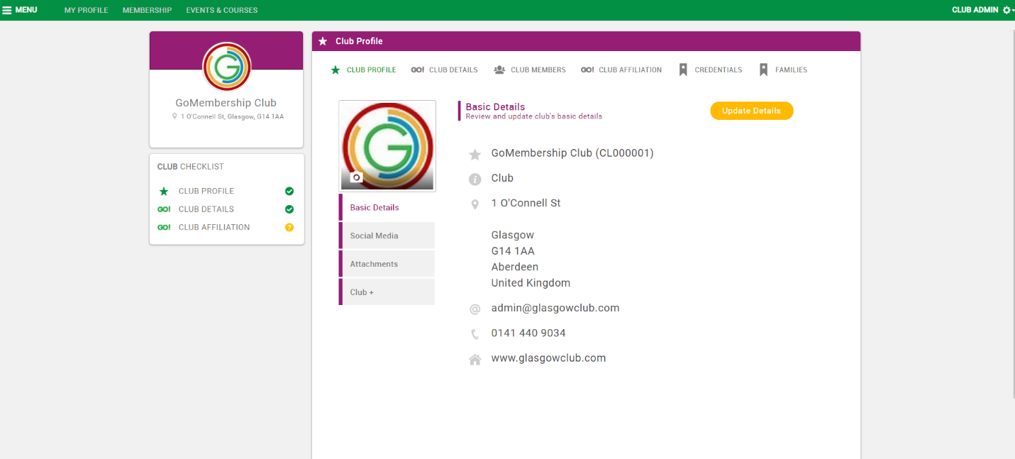
Club Profile
From the existing Club Profile page additional reports will be made available under the Club+ tab.

Slide 10
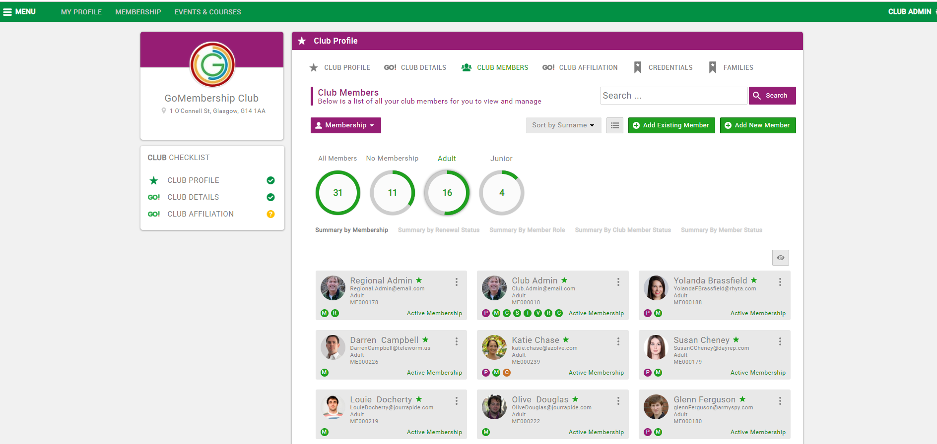
Club Members View
The Club Member tab will reveal all members associated with the club, detailing those with Club Membership of differing types, those with BMFA Membership of differing types and those with lapsed membership. Most important is the single view of this, but with the ability to filter.

Slide 11
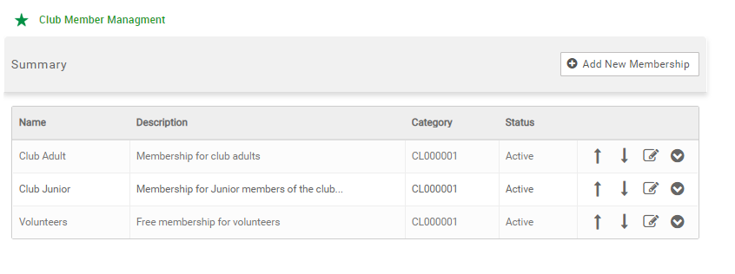
Club Membership setup
From the “Club Membership Management” tile the club administrator will be able to define as many club membership types as appropriate and the terms associated with each (starting date, period etc.)

Slide 12
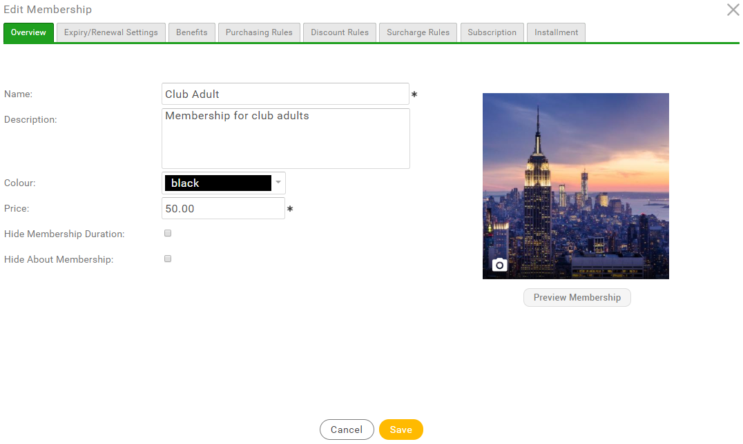

Slide 13
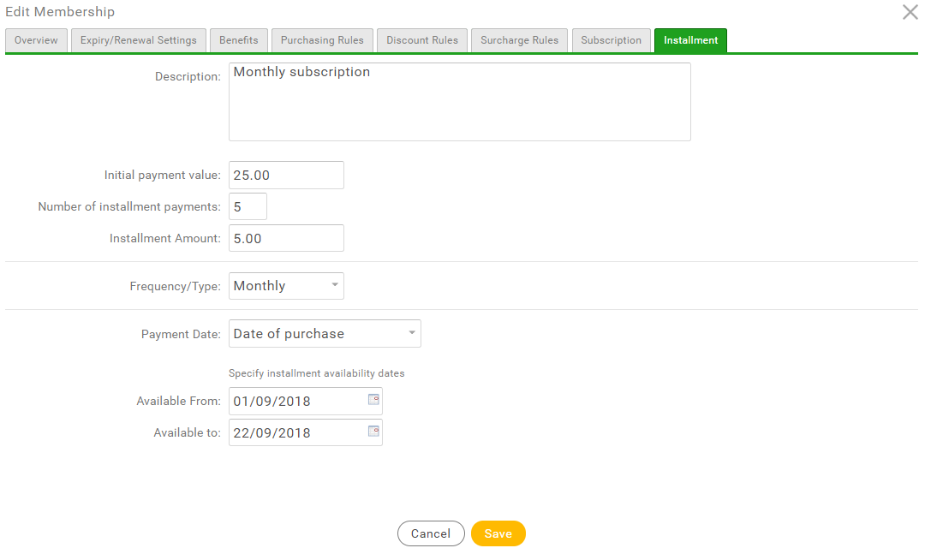

Slide 14
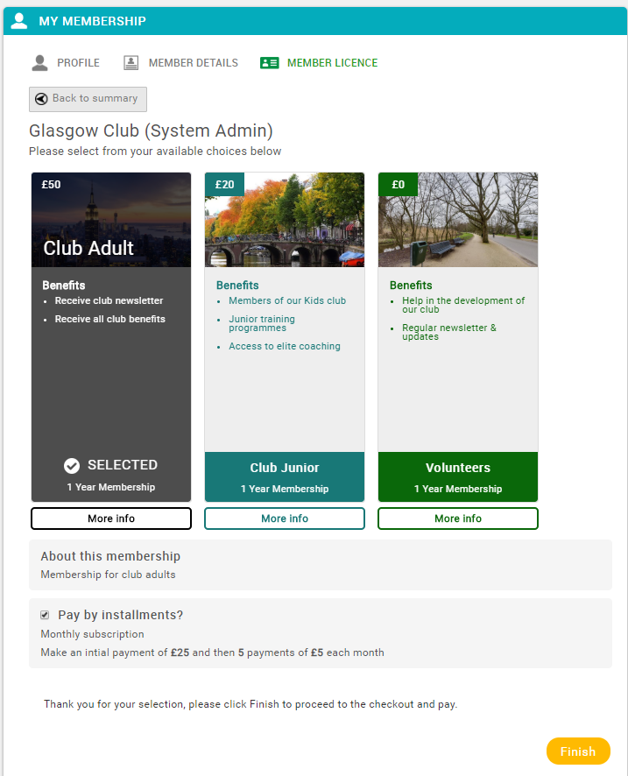
From a user perspective they will have visibility of all memberships, grouped under both the NGB’s and the Club’s defined categories. As standard, selecting one of the membership types exposes the benefits and also any additional information and options defined against it:

Slide 15
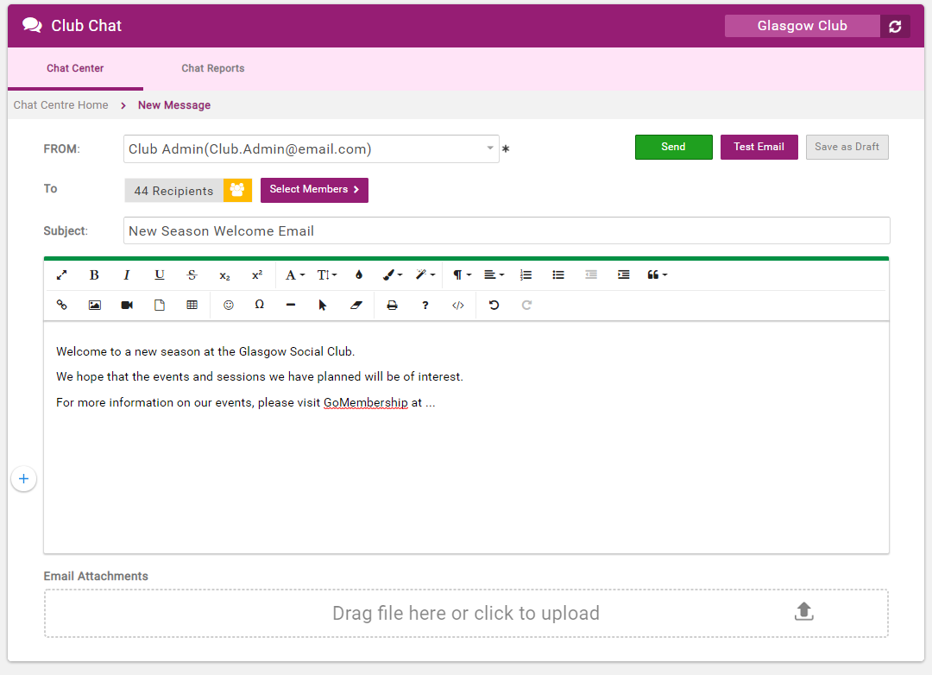
Club Communications (GDPR Compliant)
Notes:
Another major capability is the ability to communicate with some or all of the club membership community via broadcast email. The email format is very rich and includes pictures, attachments, hashtag personalisation etc. Club and NGB level “opt-in” will be taken into consideration such that if particular selected members do not wish to receive certain communications even though they are selected they won’t receive the email.

Slide 16
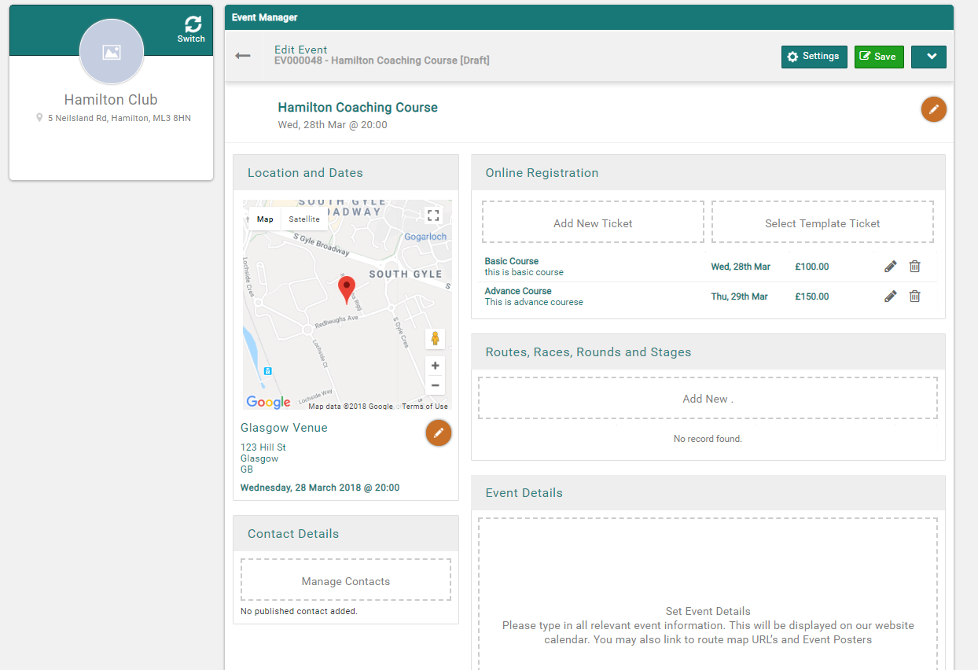
Event Management

Slide 17
Now the not so good bit!
Club+ has a cost!!!
Quarterly subscription & Transaction Charges
Quarterly subscription £25
Transaction charge 20p + 3.4%
e.g £1.90 for a £50 Clubs subs

Slide 18
Thank you for listening.

